Slide 1
Sitecore 10 Helix & Docker
What's new in Sitecore 10 and how can we use the Helix architecture?
What is Docker and how might we use it?

Slide 2
What is Sitecore Helix?
A set of design principles and conventions for Sitecore development.
Layouts, Renderings & data templates need to be build using the Helix architecture.
Data templates act as models that you can bind to renderings to display the values from Sitecore.

Slide 3
The Helix Folder Structure / Layers
Project:
Presentation
Layouts
Page Types
Feature:
Components
Functionality
Foundation:
Core functionality
Sitecore Helper Functions
3rd party libraries (e.g.. Bootstrap, jQuery)

Slide 4
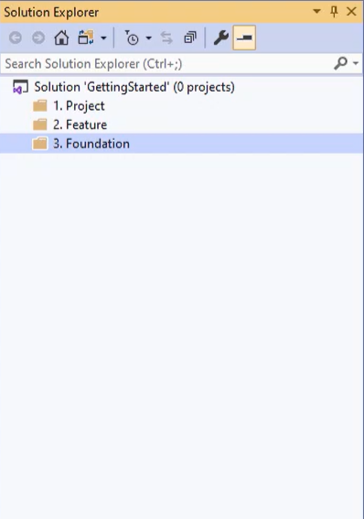
Project
This layer represents the end user interaction such as page types, layouts and styling.
The project layer holds the presentation of the website.

Slide 5
Feature
The feature layer contains concrete features of the solution as set out by the business owners and editors of the solution.
This can be the news articles, buttons, search, and any other components that will be used on the website.
A Feature should not be dependent on the Project, if two different projects need to use separate features they should be created as two separate components within a Feature.

Slide 6
Foundation
This is the lowest layer of a Sitecore Helix solution which forms the foundation of the solution.
When a change occurs in one of these modules it can impact many other modules in the solution.
This means that these modules should be the most stable in your solution. Items that are used by more than one Feature can be in the Foundation layer.

Slide 7
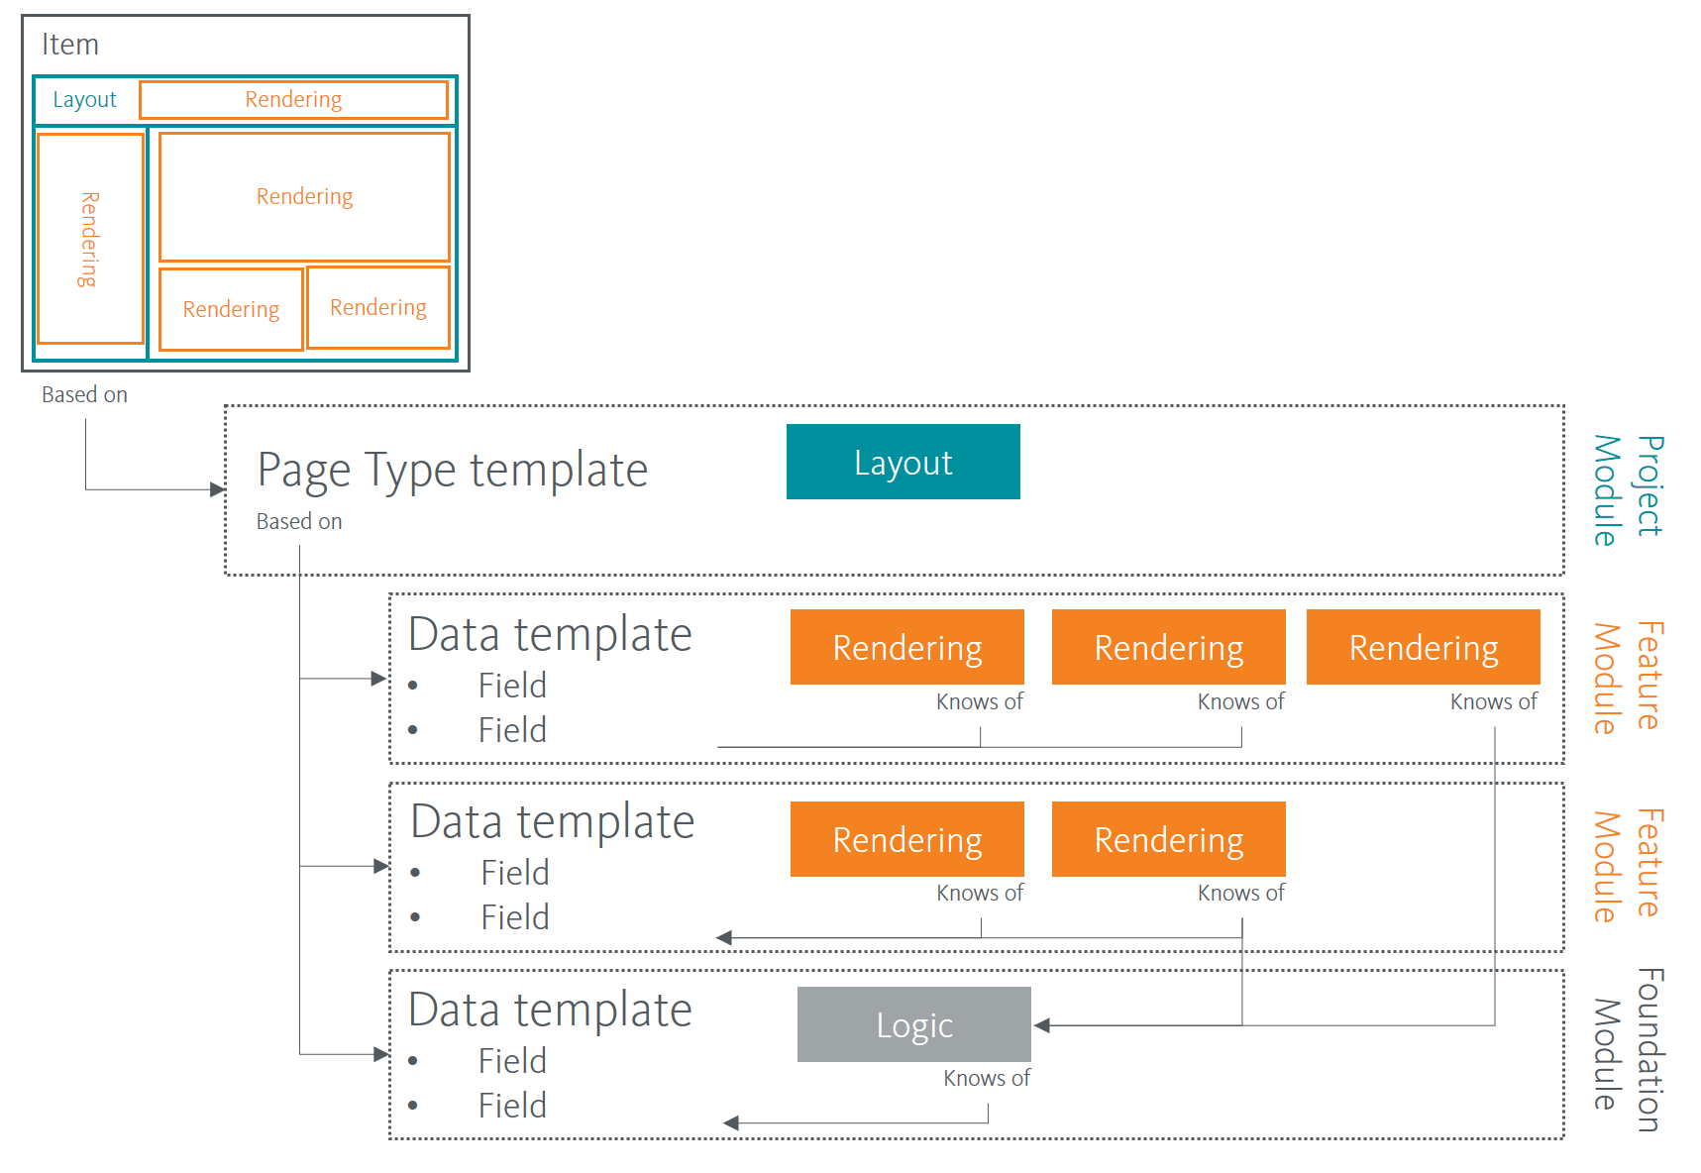
Helix Structure in Practice:

Slide 8
Managing dependencies
In a Sitecore Helix Solution, code in the Project layer can only depend on the Feature layer.
The code in the Feature layer can only depend on the Foundation layer.

Slide 9
Why use Sitecore Helix
Sitecore's Helix architecture is currently required for all Sitecore implementations.
The 3 layers combine to manage dependencies to help streamline development.
Changes to code only affects the project where that code is stored.

Slide 10
Creating a Project in a Helix solution
The naming conventions for a Helix project is:
SolutionName.LayerName.ProjectName
We save the project in the file system under:
src/LayerName/ProjectName/code/

Slide 11
Sitecore Helix Extensions for Visual Studio
One of the benefits to using a standardised structure for a Sitecore solution is the ability to use extensions to create projects for you.
Sitecore Helix Templates:
Removes repetitive tasks when creating a new project in a solution by creating the boilerplate code for you.
Sitecore Rocks:
Sitecore Rocks allows you to see the entire Sitecore tree from within Visual Studio. You can do many of the things you would do in Sitecore without leaving visual studio.

Slide 12
Installation of Helix Extensions
In visual studio select ‘Extensions’ in the top toolbar.
Select ‘Online’ and search for ‘Sitecore’
Install both Sitecore Rocks & Sitecore Helix Visual Studio Templates
⚠ The extensions currently only work in Visual Studio 2019

Slide 13
Sitecore Helix Templates
Sitecore Helix templates allow you to quickly set up a Sitecore solution.
The extension automatically creates the folder structure and also manages the dependencies.
It installs the needed Nuget packages and sets up automatic publishing on build.

Slide 14
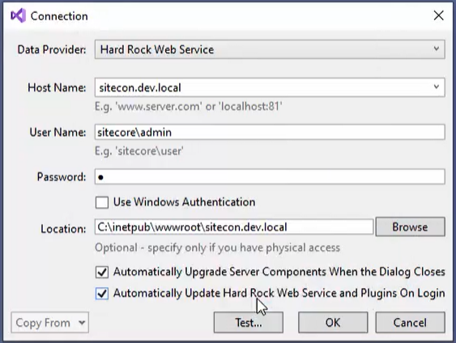
Sitecore Rocks
Once Sitecore Rocks is installed you can connect it to your Sitecore instance.
Once connected you will see your Sitecore content tree in the Sitecore Explorer.
The renderings and templates are split into Project, Feature & Foundation.

Slide 15
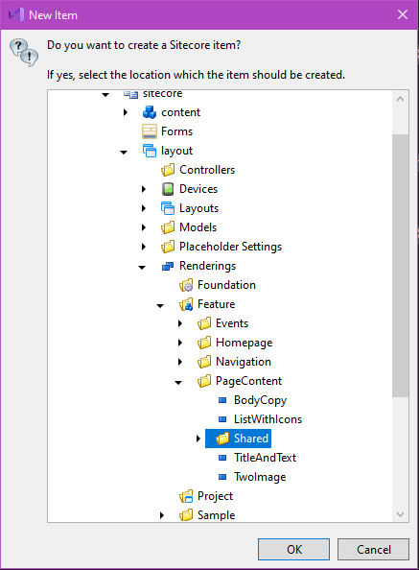
Creating Sitecore Items within Visual Studio
There are many Sitecore specific items that you can add to a solution using the extensions.
For example you can create a Sitecore view rendering:
The extension will then ask you where to store the rendering within Sitecore:

Slide 16
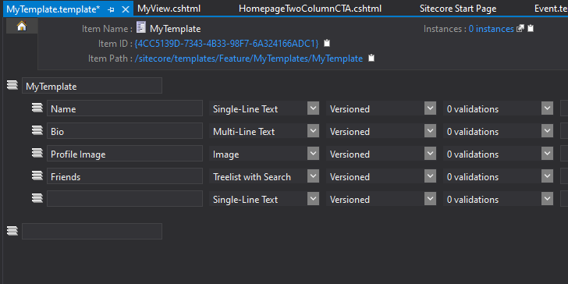
Adding a data template
You can also create data templates within Visual Studio using Sitecore Rocks:
Once created you can define field names and field data types:

Slide 17
How to ‘Helixify’ a component
The next slides outline the process of updating an old component to use the Helix architecture.

Slide 18
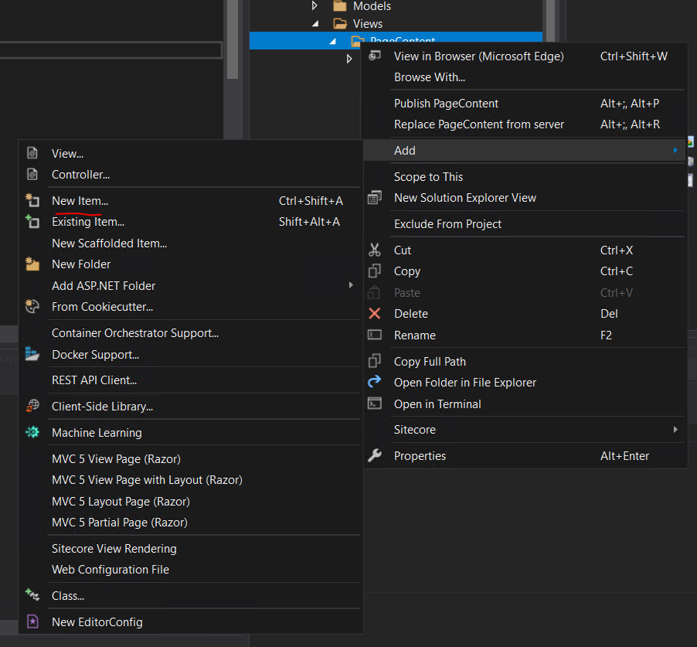
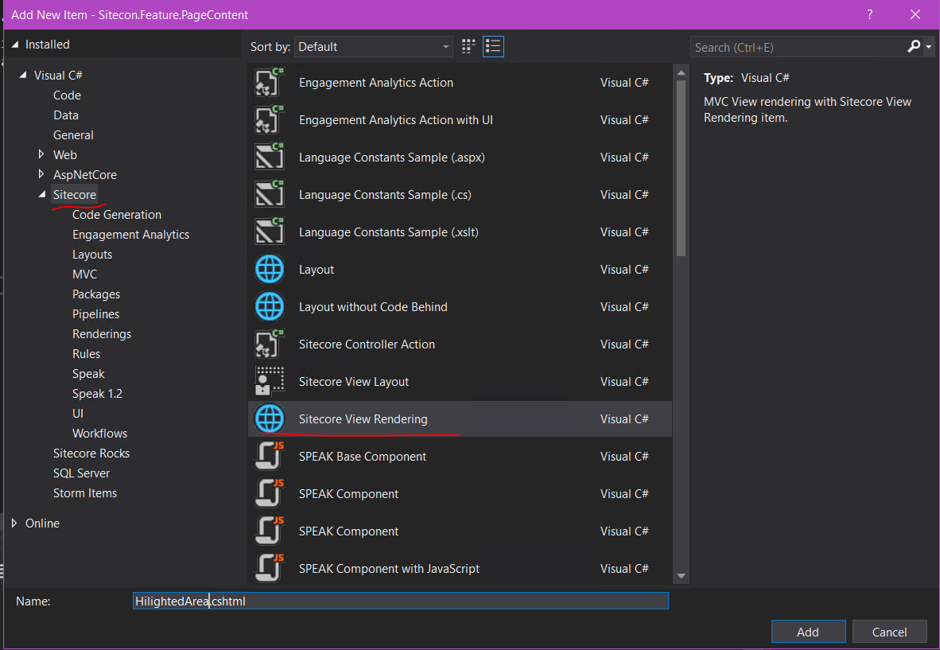
Add a new Sitecore View rendering under Feature.Views.PageContent

Slide 19
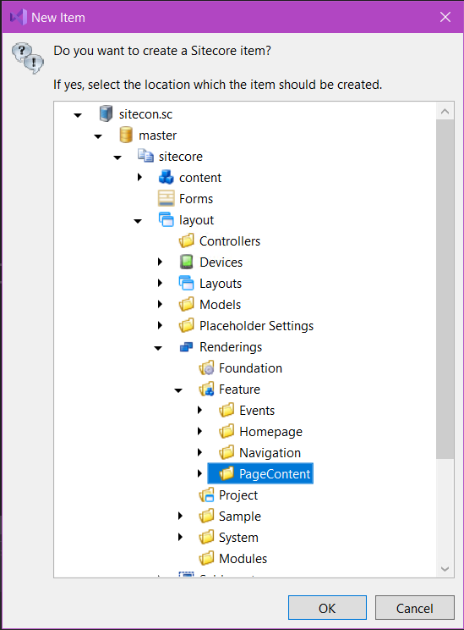
A Sitecore Rocks dialogue will pop up, select where to store the rendering in Sitecore…

Slide 20
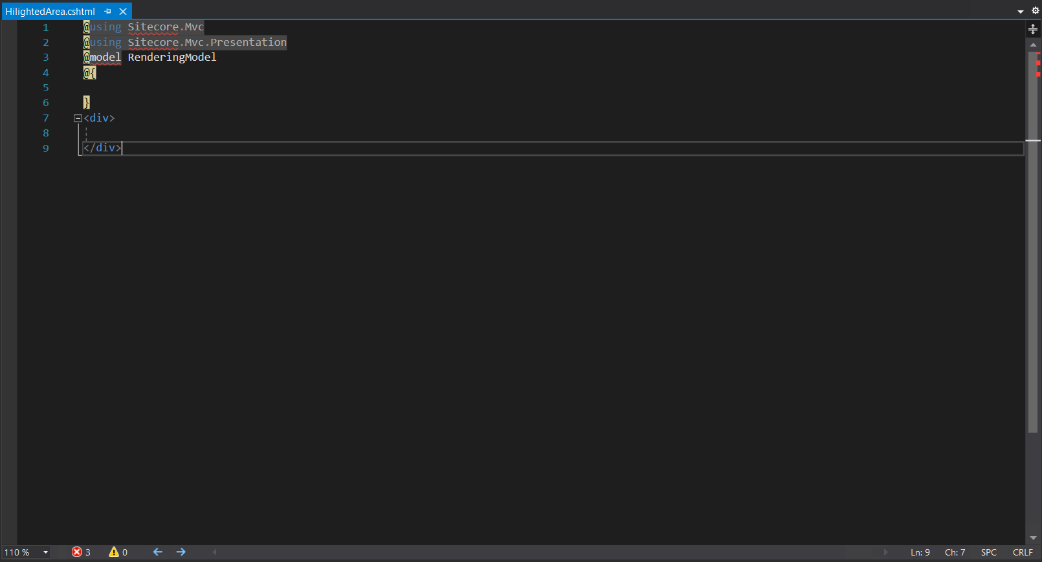
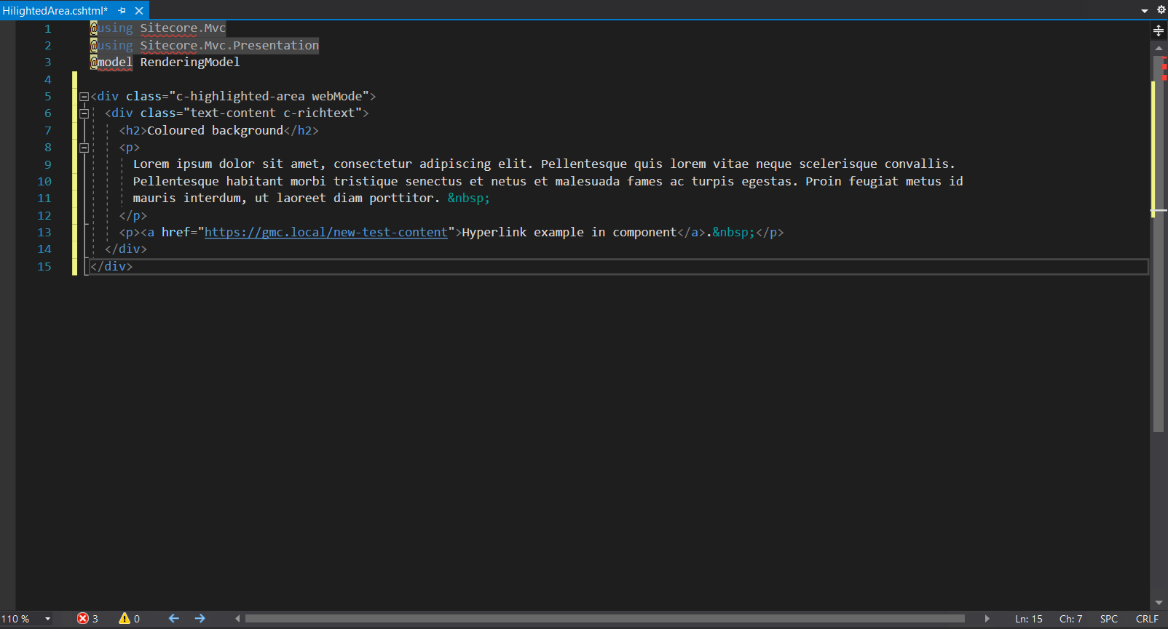
This will create an empty Sitecore View Rendering. Add the HTML for the component…

Slide 21
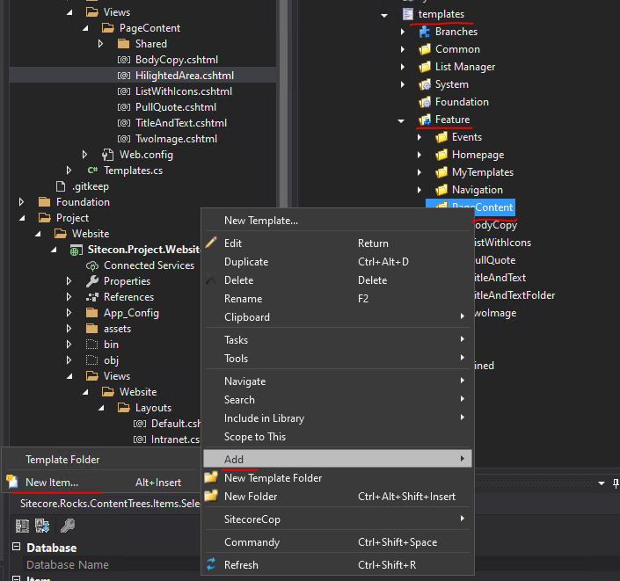
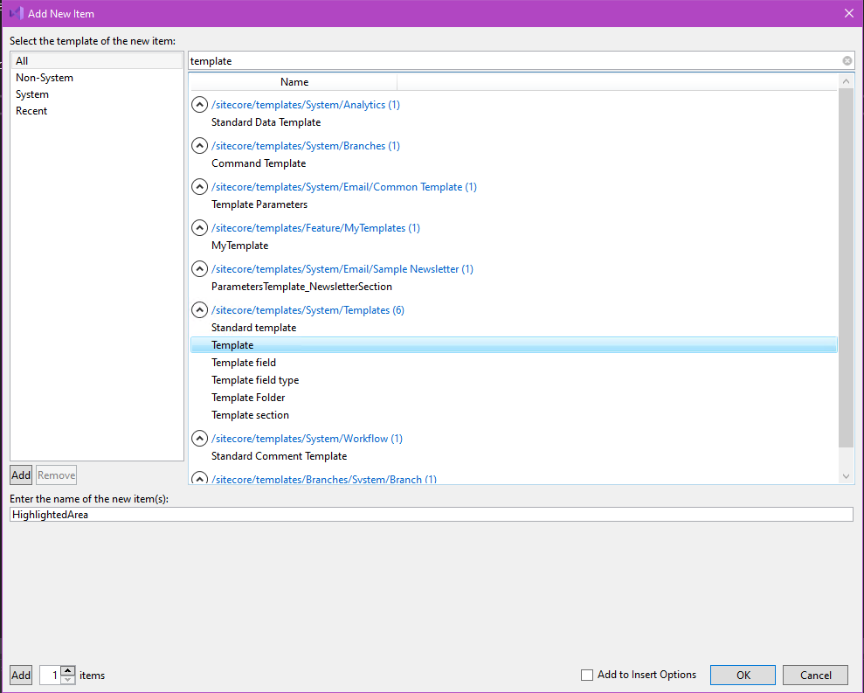
Then create a data template for the component under Feature.PageContent

Slide 22
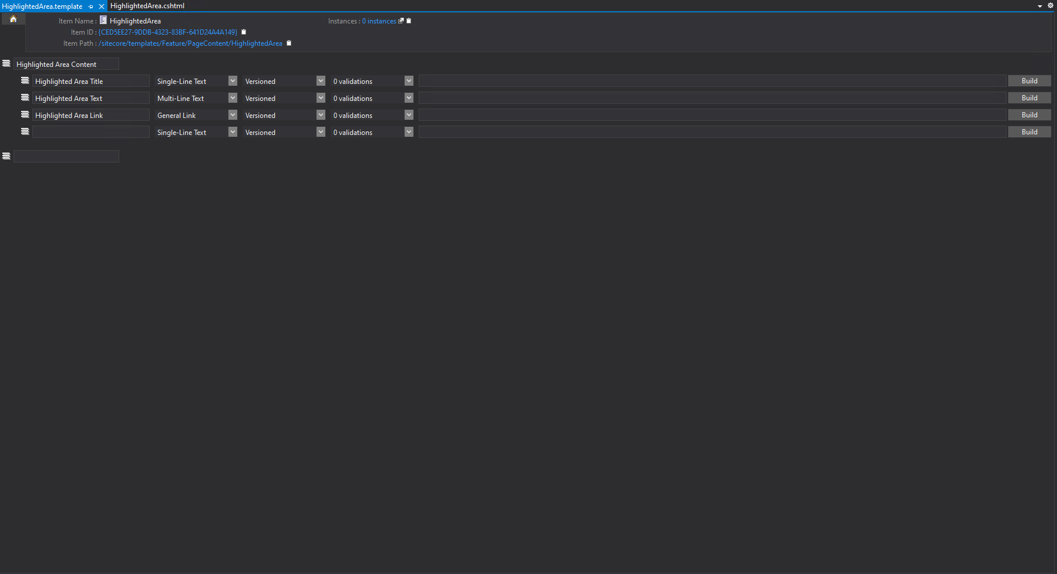
This will open a page where you can add the template field names and chose the field type

Slide 23
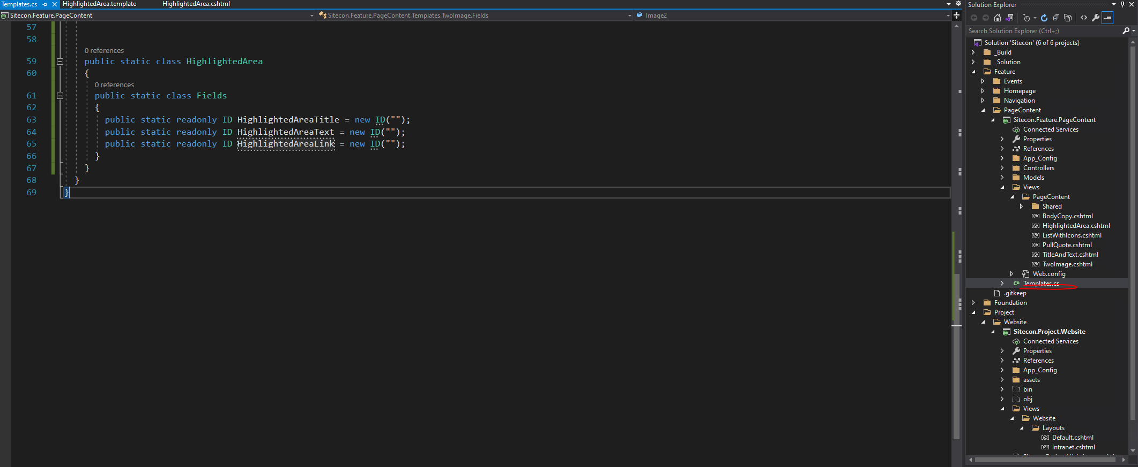
In the Feature layer there is a file called Templates.cs
The Templates.cs file is used by the Sitecore View Renderings to populate the content.
It stores the Item ID’s that are used like:
@Html.Sitecore().Field(“{ID_FROM_TEMPLATES.CS_HERE}”)

Slide 24
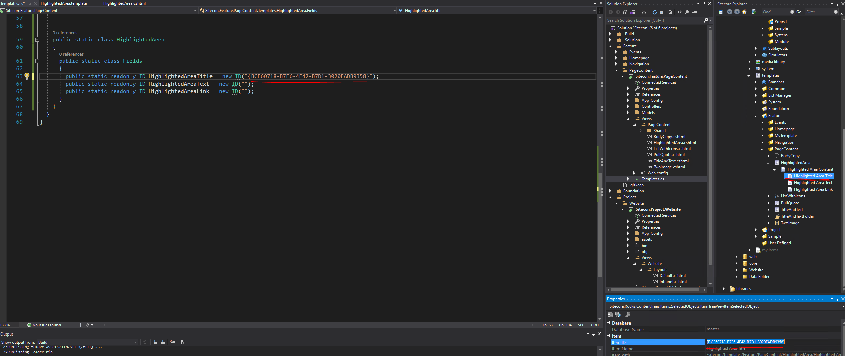
Get the ID’s of the data values from Sitecore Rocks and add them to the Templates.cs file

Slide 25
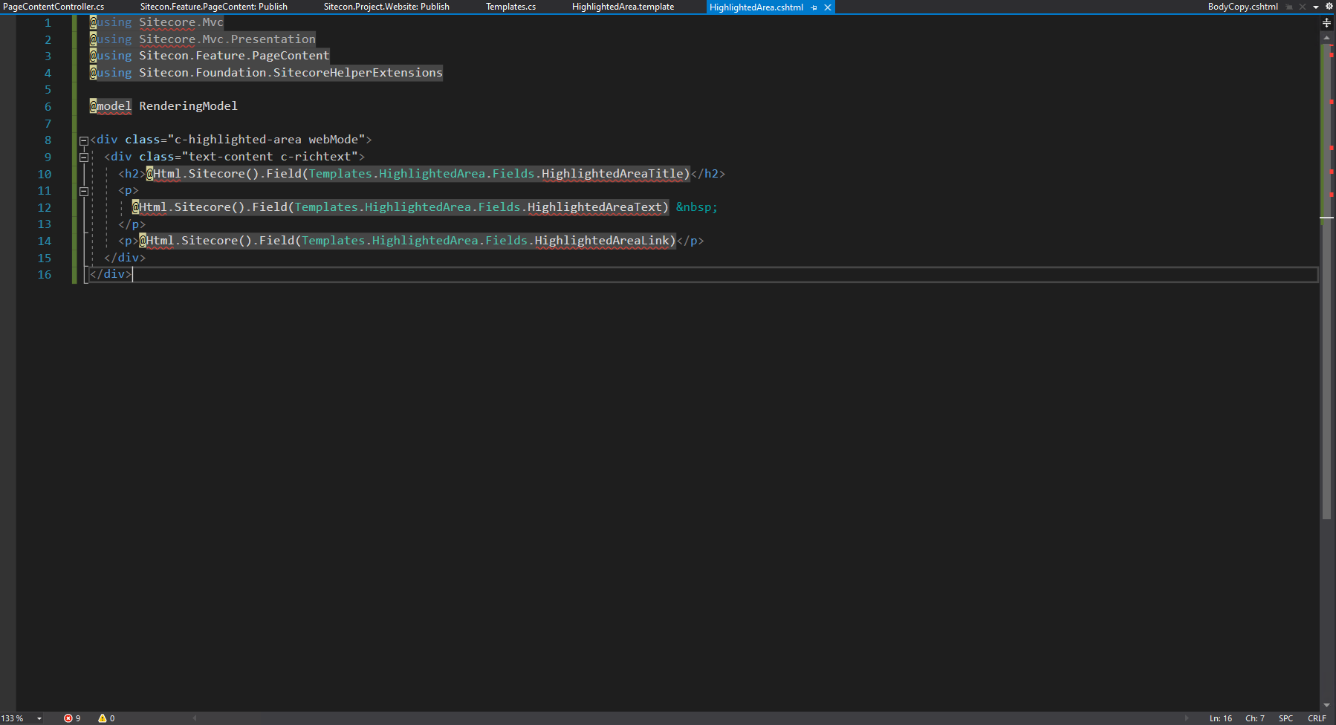
Add the fields to the Sitecore View Rendering and publish the solution

Slide 26
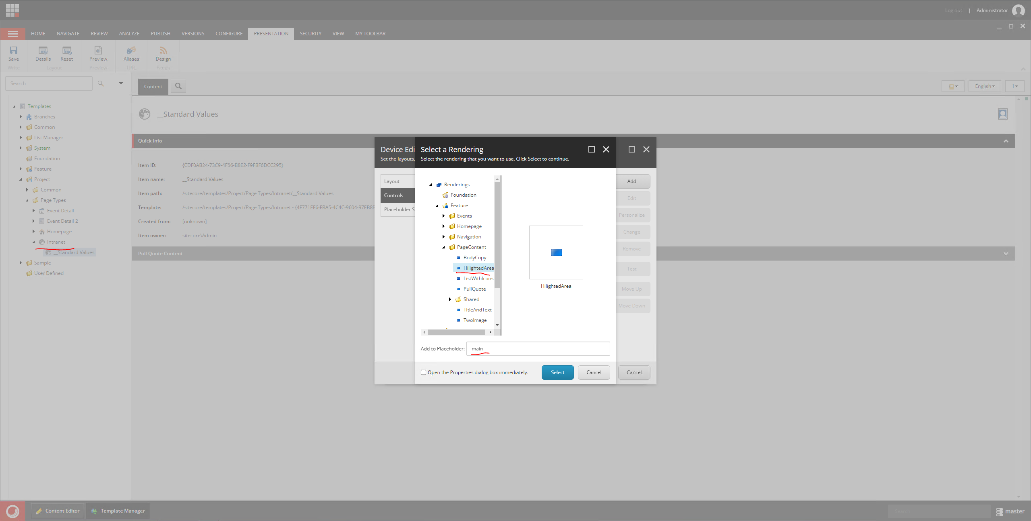
In Sitecore, add the rendering to a page type

Slide 27
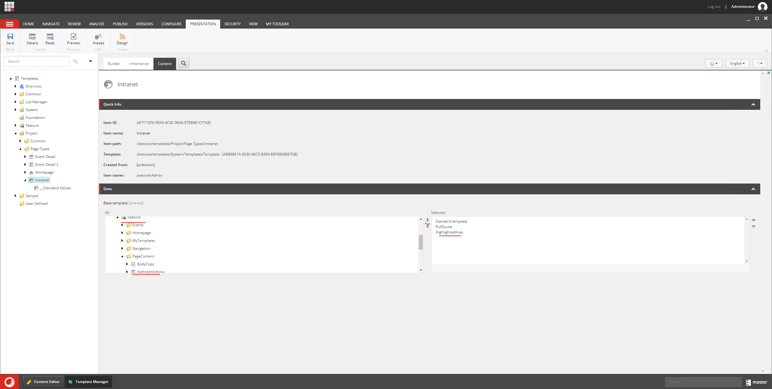
Add the data template to the page in Sitecore

Slide 28
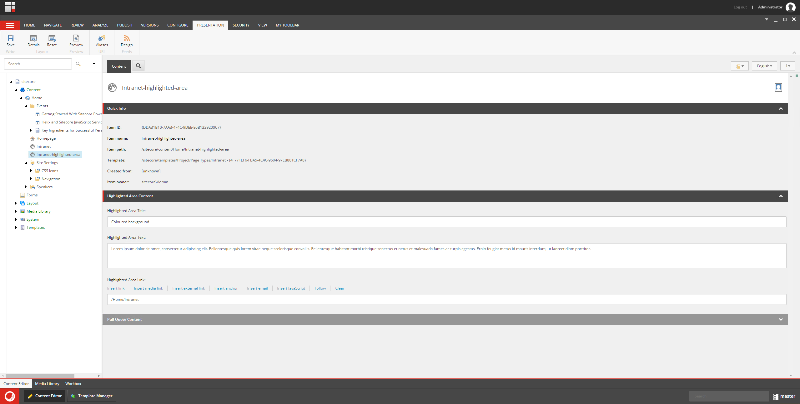
In the content editor, add the content to the component and publish!

Slide 29
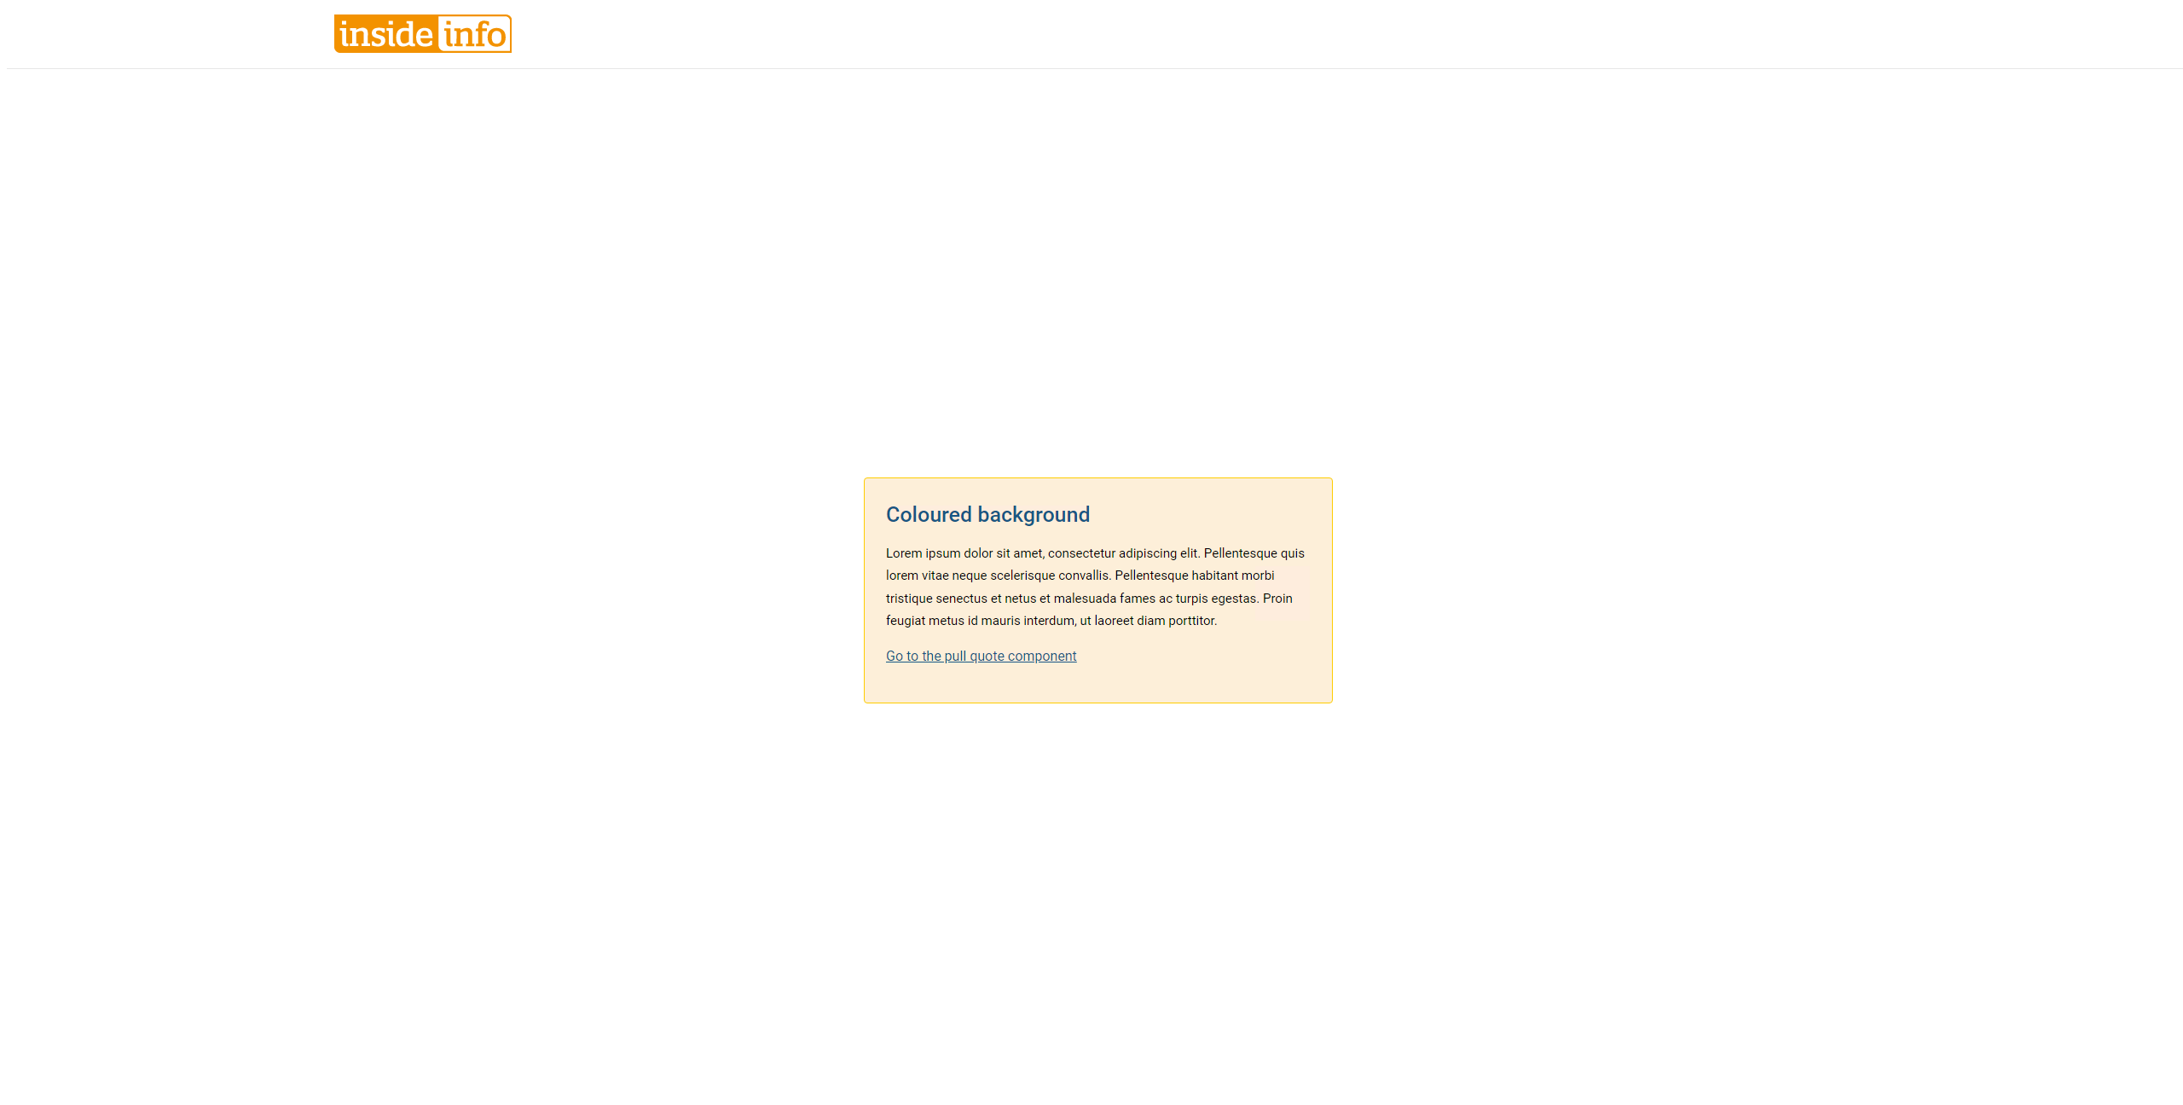
Navigate to the published page to see the final result:
That’s all for Sitecore 10 and Helix.
Any questions?
Next up: Docker

Slide 30
Docker
What is Docker?
What is a container?
What are the advantages of Docker over traditional VM based deployment?

Slide 31
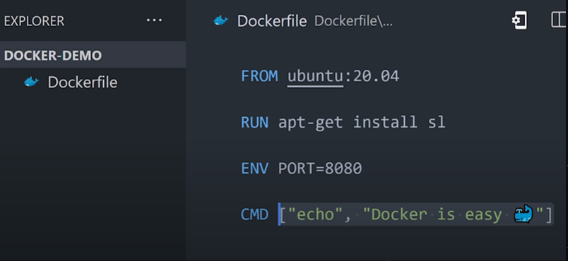
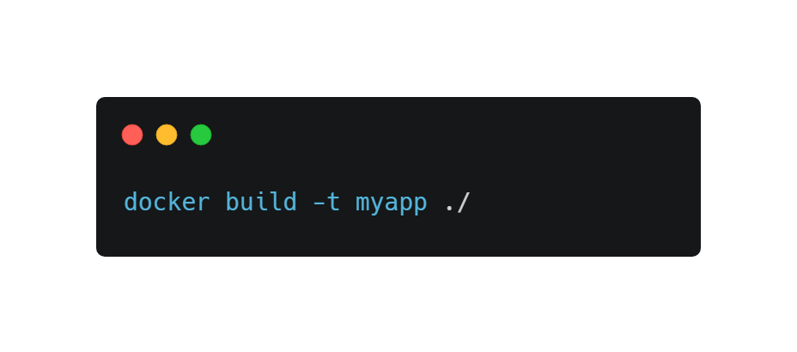
What is Docker?
Docker is a way of packaging software and OS settings so they can be run on any machine.
There are 3 elements to Docker:
Docker file
Image
Container
The Docker file is code that tells Docker how to build an image.
An image can then be run using Docker to create one or many containers running the OS and software including all of the required dependencies.
Example Docker file

Slide 32
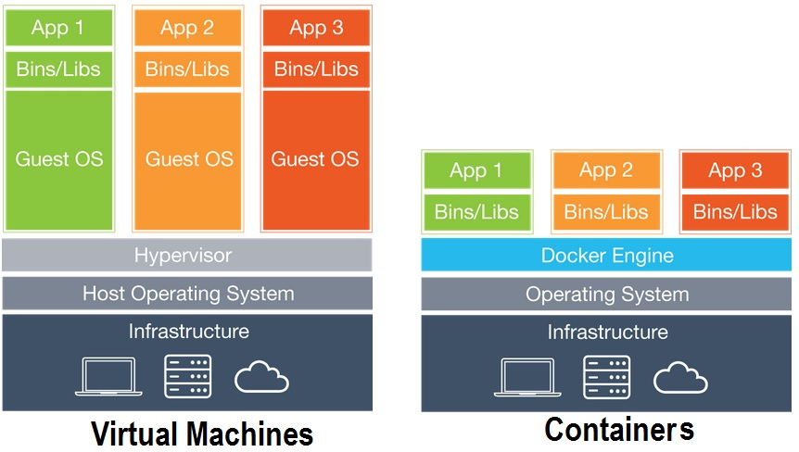
Virtual Machines vs Docker Containers
A virtual machine uses a hypervisor to manage resources between different installations.
Each installation has an operating system and it’s own kernel which makes them slow and bulky.
The Docker engine allows multiple installations of an operating system to use the same base kernel to run the applications.
This means that each installation uses less resources and is quicker to boot up & create.

Slide 33
What is a container?
A container is a ‘Micro Computer’ which can run any program on any hardware.
They can have:
Operating System
Memory
CPU
Networking
Each container is completely isolated and lightweight.

Slide 34
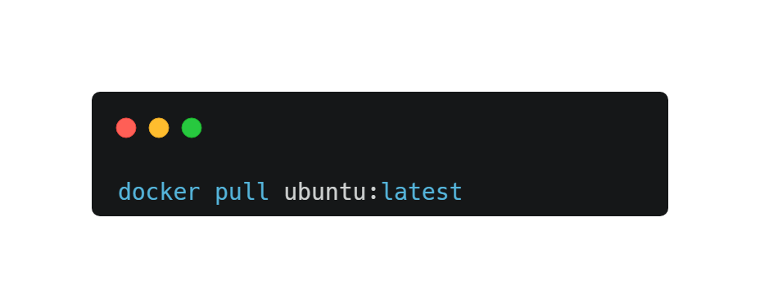
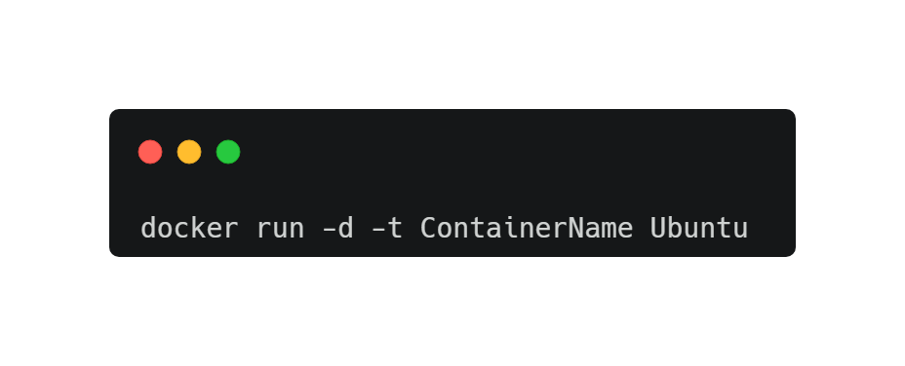
Creating a Docker container
To create a Docker container you first need to decide what base image to use.
You can go to the Docker Hub hub.docker.com to select an image. This could be a Linux OS like Debian or a SQL server container etc..
Then to run your container you use Docker run with a name for the container and the base image.
The container will instantly be created and be up and running. This is much quicker than installing and booting up a traditional virtual machine.

Slide 35
Benefits of using Docker containers
One of the major benefits of containers is for testing, this is because the container holds:
The exact OS version
All of the settings the user has applied
The exact configuration
All of the prerequisites / dependencies
And it’s all there in one single package that can be uploaded/downloaded from the cloud and run with just a couple of commands.
They are entirely portable and will run on any host computer.

Slide 36
Why is Docker so fast?
The main reason is the fact that you only need one kernel.
Each container can use the same base kernel to run the operating system making each container much more lightweight and therefore more cost effective to run.
🛈 Windows containers can only be run on windows based systems and vice versa

Slide 37
How could the GMC use Docker?
We could install Sitecore within a Docker container which would allow anyone to pull down a developers exact setup without following the normal installation steps.
We can have SQL server instances inside their own containers.
All of the GMC’s APIs could be containerised.
The test – dev – prod servers can all be in containers and through the use of Kubernetes it’s possible for infinite scalability.

Slide 38
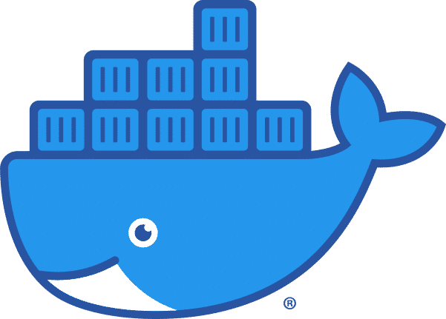
Thanks for listening
Any questions?
10.0

